Slide 1
Name of Students: Shubham Pralhad Babar (02)
Vivek Gunvant Nikam (53)
Shubham Vitthal Pawar (58)
Research Paper Topic: “Role of Artificial Intelligence in game development”

Slide 2
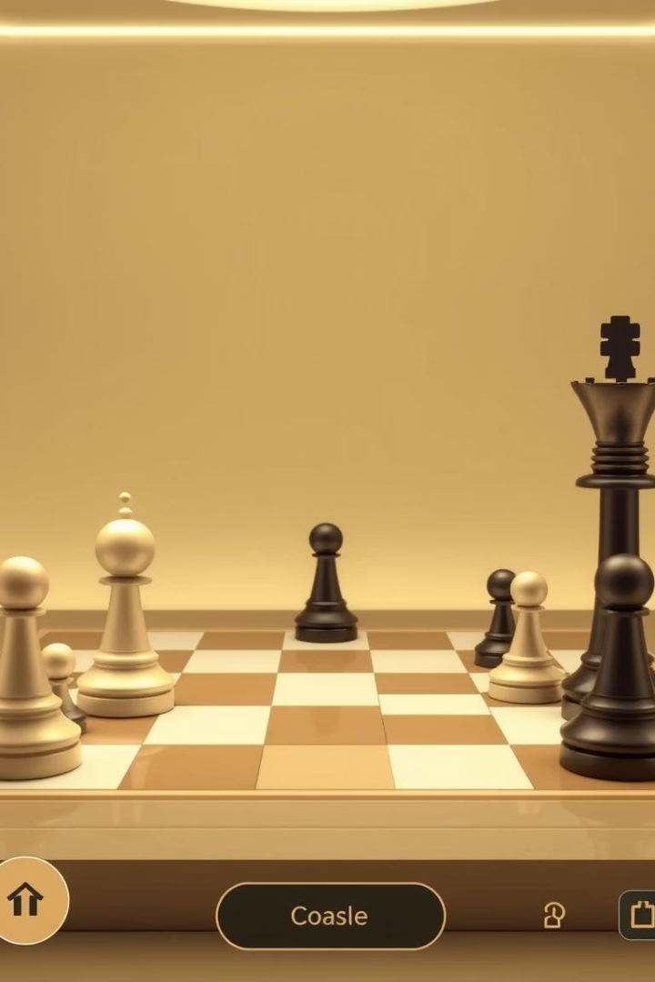
Role of Artificial Intelligence in Game Development
This research project explores the transformative role of Artificial Intelligence (AI) in enhancing game development. It focuses on AI techniques applied to gameplay mechanics, NPC behaviour, environment generation, and player interaction to create dynamic and immersive gaming experiences.
Technologies like Python, HTML, JavaScript, and AI engines such as Stockfish and Lc0 were integrated to develop an intelligent chess game with real-time adaptive decision-making and multiplayer capabilities.

Slide 3
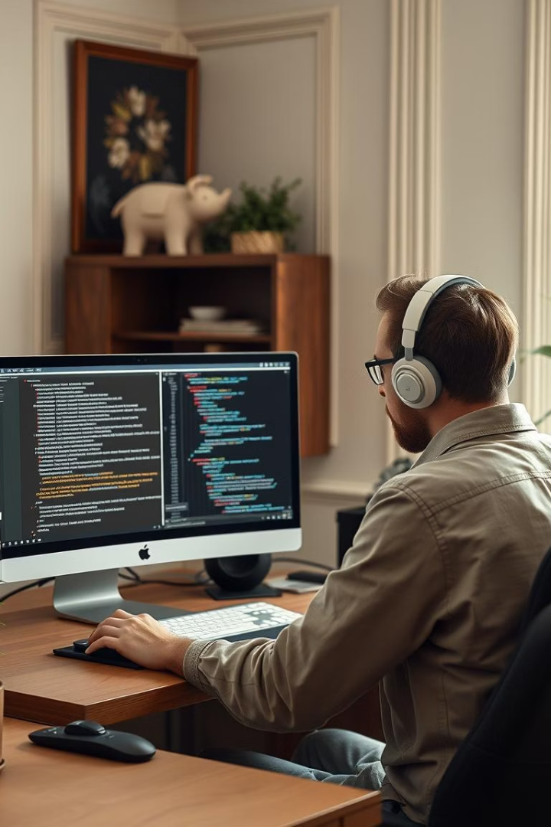
Introduction and Problem Statement
Introduction
Problem Statement
AI has revolutionized game design by enabling adaptive environments, intelligent NPCs, and immersive gameplay that responds to player actions.
Traditional games often have scripted, predictable AI with limited personalization and static mechanics, reducing player engagement over time.
Project Aim
To develop a smart AI-powered game system using Stockfish, Lc0, Python, and web technologies that delivers dynamic, strategic, and personalized gameplay.

Slide 4

Research Objectives
1
Develop AI-Based Game Engine
Integrate Stockfish and Lc0 to simulate intelligent opponents with real-time strategic decisions.
2
Implement Smart Decision Systems
Use AI algorithms like Minimax and behaviour trees for adaptive gameplay responding to player actions.
3
Build Interactive Interface
Create a responsive browser-based UI with HTML, CSS, and JavaScript for engaging user experience.
4
Enable Remote Testing
Use Ngrok for secure tunnels allowing real-time multiplayer testing and remote access.

Slide 5
Literature Review Highlights
AI in Games Survey
Stockfish Engine
Leela Chess Zero (Lc0)
AI-Powered Web Games
Explores AI techniques like adaptive difficulty, player modelling, and procedural content generation enhancing immersion.
Powerful chess AI using alpha-beta pruning and heuristics for superhuman gameplay and move evaluation.
Neural network-based engine learning through self-play, offering human-like strategic decision-making.
Discusses Python and JavaScript integration with REST APIs and Ngrok for scalable, real-time AI gameplay.

Slide 6




Data Collection and Preprocessing
Sources of Data
Game databases like OpenAI Gym, Unity Asset Store for NPC behaviours and mechanics.
Player feedback from Steam and Reddit to refine AI decision-making.
Synthetic data simulating in-game scenarios for training AI models.
Data Types Collected
Player behaviours and decision patterns.
Game mechanics and interaction rules.
AI performance and game event logs.
Preprocessing Steps
Normalization and outlier removal for data consistency.
Data augmentation and tokenization for narrative processing.

Slide 7
Working Model and System Architecture
System Architecture
Functional Workflow
Communication Flow
Modular design combining frontend interface with backend AI logic for smooth, intelligent gameplay.
Users interact via web UI; AI engines process moves and provide real-time responses and commentary.
Sequence diagrams illustrate data exchange between user inputs, AI decision modules, and game state updates.

Slide 8
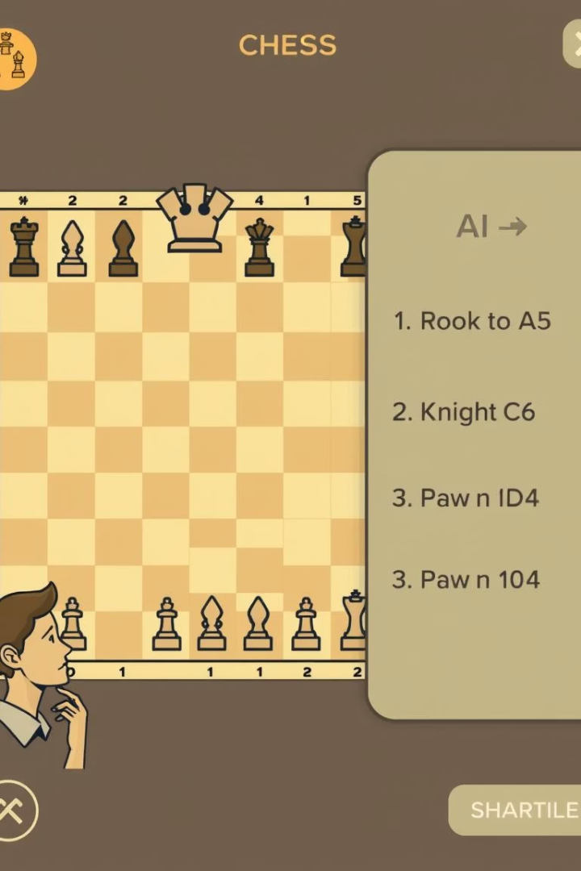
Observations and Testing Results
Test Case
Player Move
AI Response
Outcome
1
Pawn to E4
Pawn to E5
Balanced opening with AI counter strategy
2
Knight to F3
Knight to C6
AI controls center, follows classical theory
3
Queen to H5
Pawn to G6
Defensive move protecting king-side
AI provided contextual remarks enhancing realism and engagement during gameplay.

Slide 9

Results and User Feedback
Functional Achievements
User Experience
Accurate move recognition, strategic AI decisions, smooth gameplay flow, and interactive interface.
95% found the interface intuitive; AI interaction described as life-like and engaging.
Suggestions
Undo move feature
Move hints for beginners
Adjustable difficulty levels

Slide 10





Future Scope of Research
2. Difficulty Customization
1. Advanced AI Algorithms
Implement Elo rating-based levels and dynamic skill adjustment for inclusive challenges.
Integrate Minimax with Alpha-Beta pruning and deep learning for smarter, human-like gameplay.
2
1
5. Multiplayer and Social Features
Enable online matches, live AI commentary, leaderboards, and gamification elements.
3
5
4. AI-Powered Learning Mode
Offer move explanations, scenario training, and personalized tutorials for education.
4
3. Mobile Application
Develop cross-platform apps with offline mode and touch-optimized interfaces.

Slide 11

Limitations and Conclusion
Conclusion
Performance Constraints
The project successfully demonstrates AI’s transformative role in game development, delivering an intelligent, engaging chess experience and laying groundwork for future innovations.
Limitations
May face lag on low-end devices; ethical and legal considerations around AI usage remain.
Current AI lacks deep strategic complexity and multiplayer support; some chess rules are incomplete.

Slide 12
Thank You..

